Slide 1
Web程式設計
課程介紹
授課教師:陳錫民
Email: hmchen@mail.fcu.edu.tw

Slide 2
授課老師
陳錫民
Email: hmchen@mail.fcu.edu.tw
請益時間
星期三 14:00 – 15:00, 16:00~17:00
星期四 15:00 – 17:00
請益地點
資電213

Slide 3
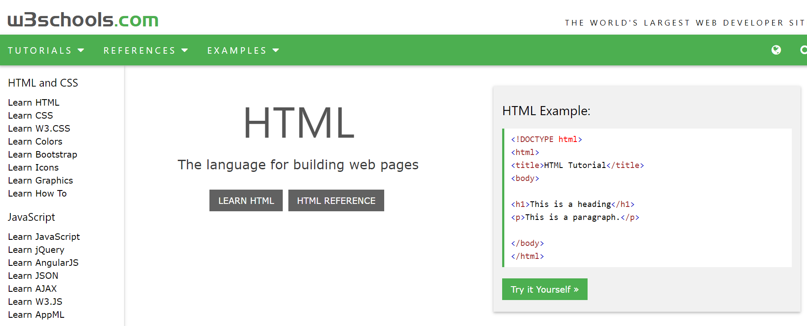
教科書
w3schools
https://www.w3schools.com/
上課講義下載：
http://ilearn2.fcu.edu.tw/

Slide 4
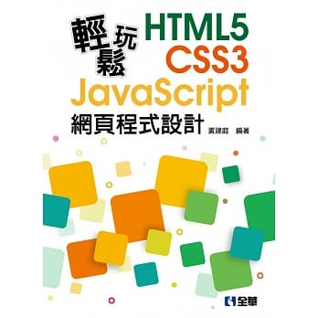

參考書
輕鬆玩HTML5＋CSS3＋JavaScript網頁程式設計, 全華
Internet & World Wide Web, Pearson

Slide 5
What is Web?
World Wide Web (WWW)
全球資訊網
萬維網 (万维网)

Slide 6

What is Web?
a system of interlinked hypertext documents accessed via the Internet (網際網路).
With a web browser （瀏覽器）, one can view web pages that may contain text, images, videos, and other multimedia and navigate between them via hyperlinks

Slide 7
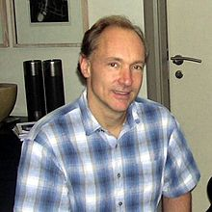
History of Web
Tim Berners-Lee
November 1990
published a formal proposal to build a "Hypertext project" called "WorldWideWeb"
as a "web" of "hypertext documents" to be viewed by "browsers"
using a client–server architecture

Slide 8
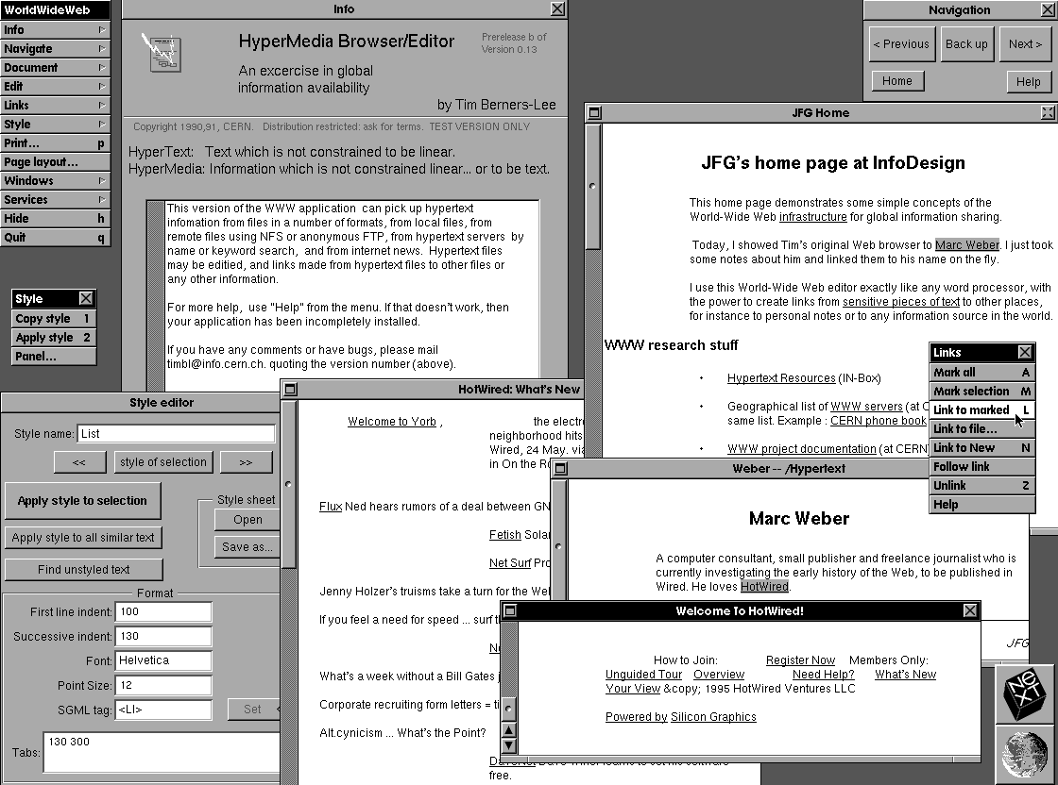
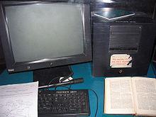
History of Web
In 1990
A NeXT Computer was used as the world's first web server and also to write the first web browser, WorldWideWeb

Slide 9
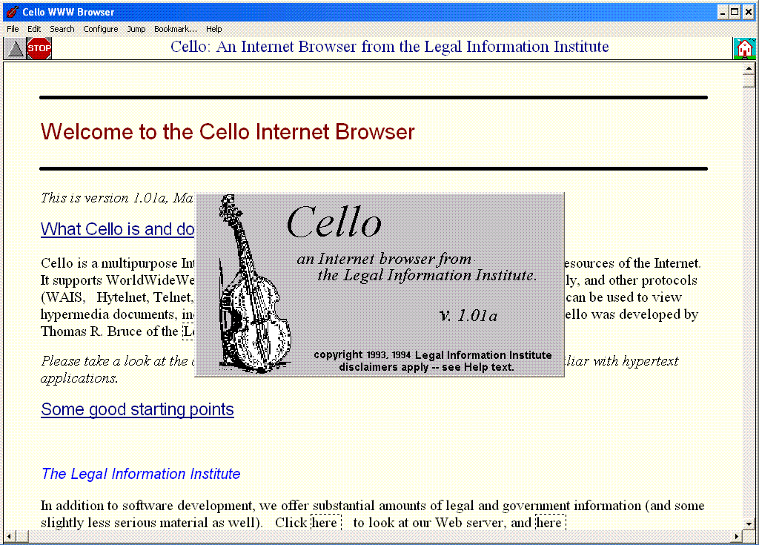
History of Web browser
1992 Cello
for Windows 3.1, developed by Thomas R. Bruce

Slide 10
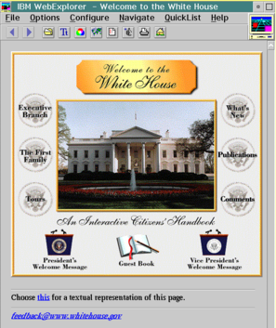
History of Web browser
1994 IBM WebExplorer

Slide 11
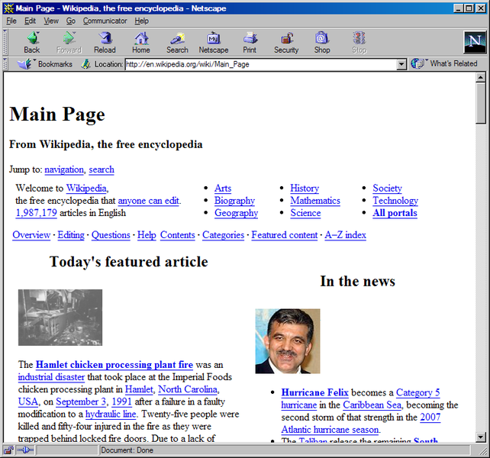
History of Web browser
1994 Netscape Navigator

Slide 12
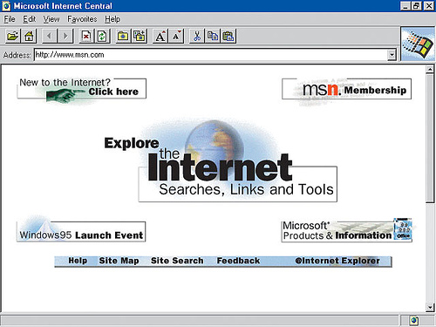
History of Web browser
1995 Microsoft Internet Explorer

Slide 13
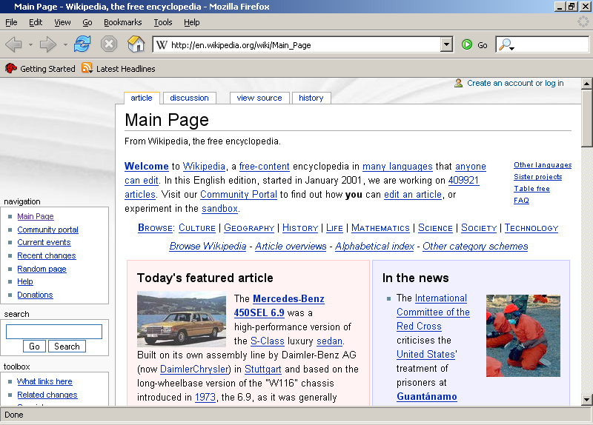
History of Web browser
2002 Mozilla Firefox

Slide 14
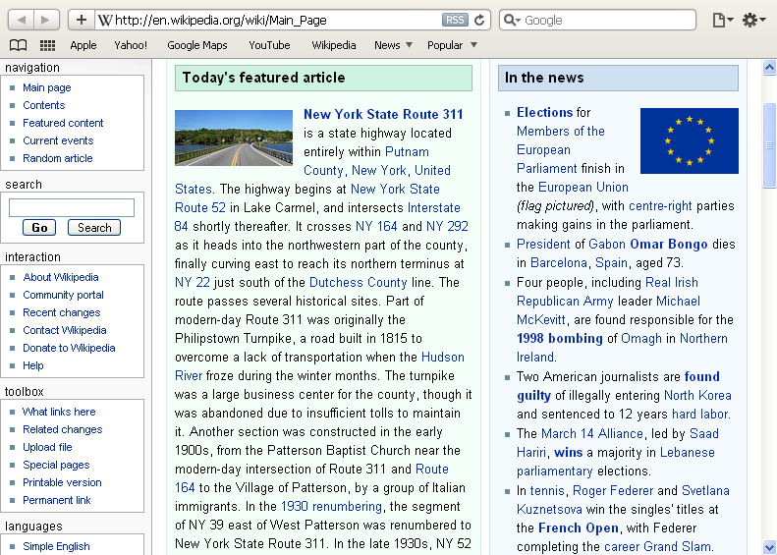
History of Web browser
2003 Apple Safari

Slide 15
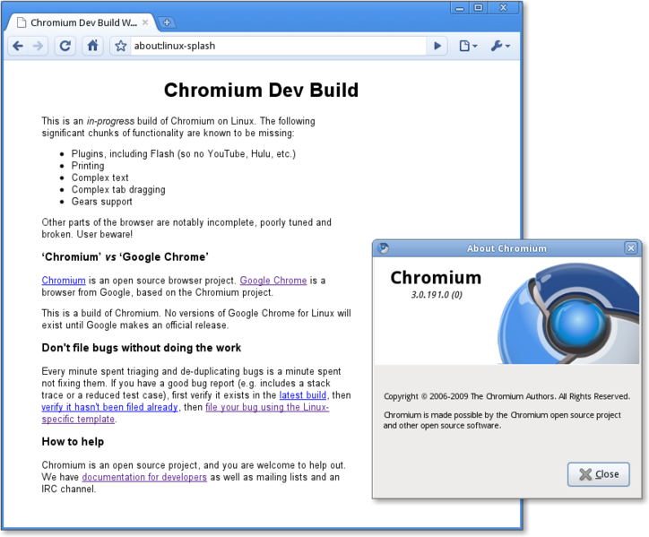
History of Web browser
2008 Google Chrome

Slide 16
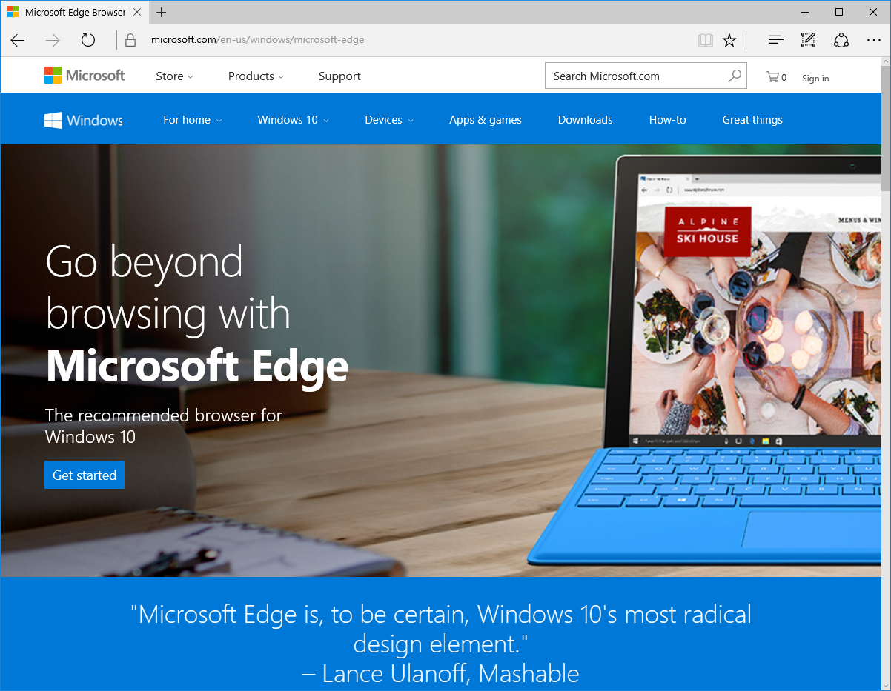
History of Web browser
2015 Microsoft Edge

Slide 17
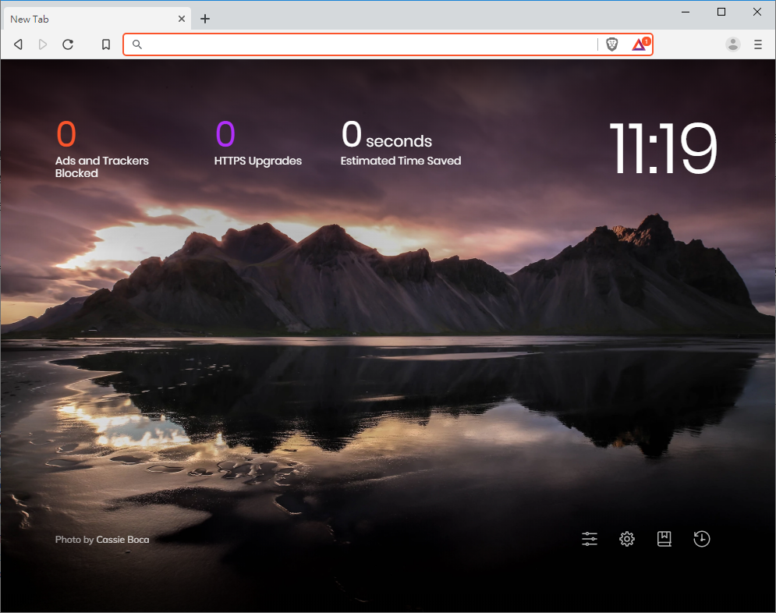
History of Web browser
2016 Brave

Slide 18
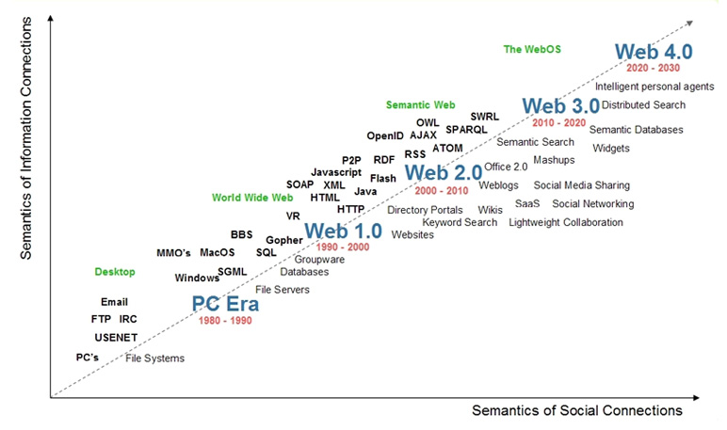
Evolution of Web technologies

Slide 19
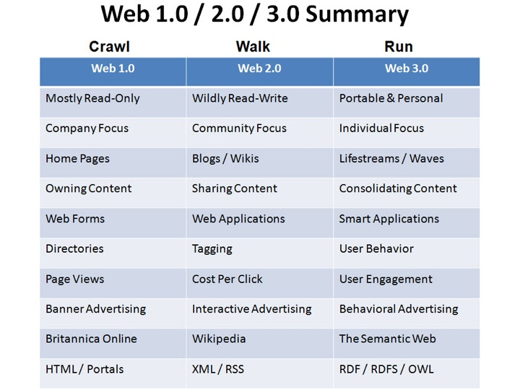
Evolution of Web technologies

Slide 20
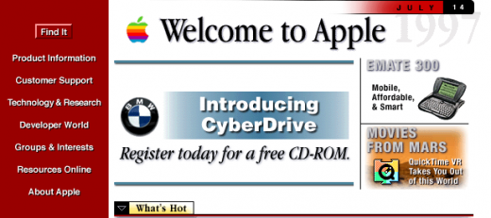
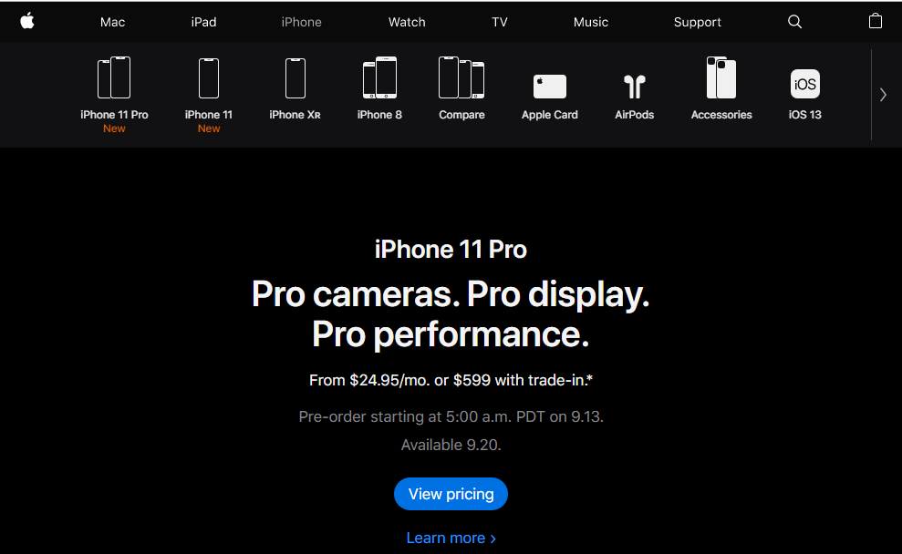
Evolution of Web technologies
Web 1.0
Today

Slide 21
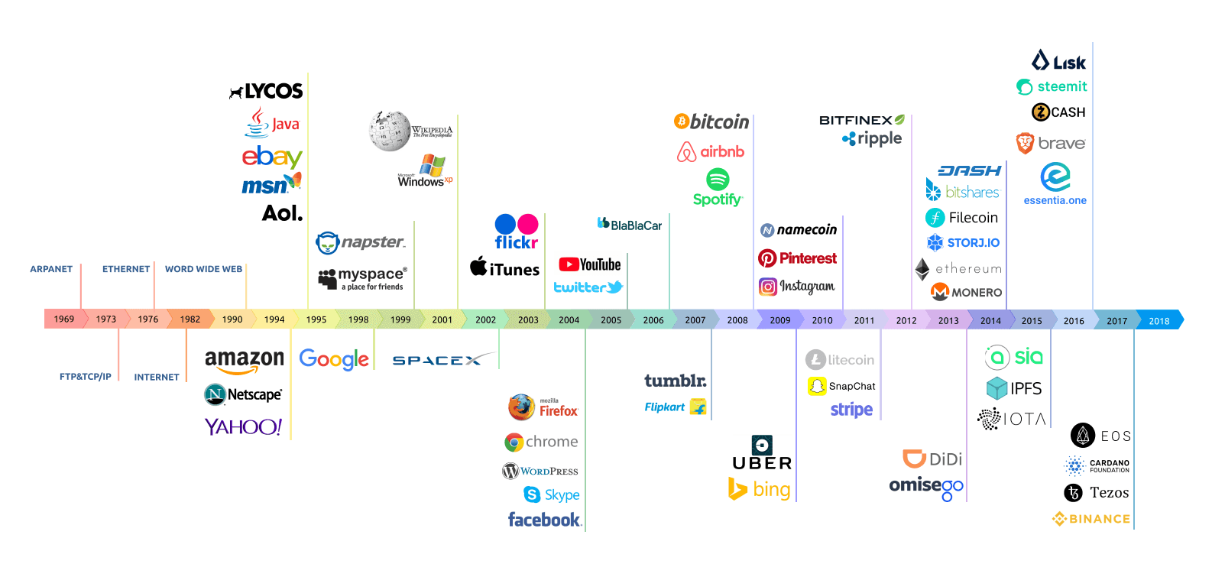
Evolution of Web technologies

Slide 22
Three essential technologies of Web
URL: a system of globally unique identifiers for resources on the Web
HTTP: the Hypertext Transfer Protocol
HTML: the publishing language HyperText Markup Language

Slide 23
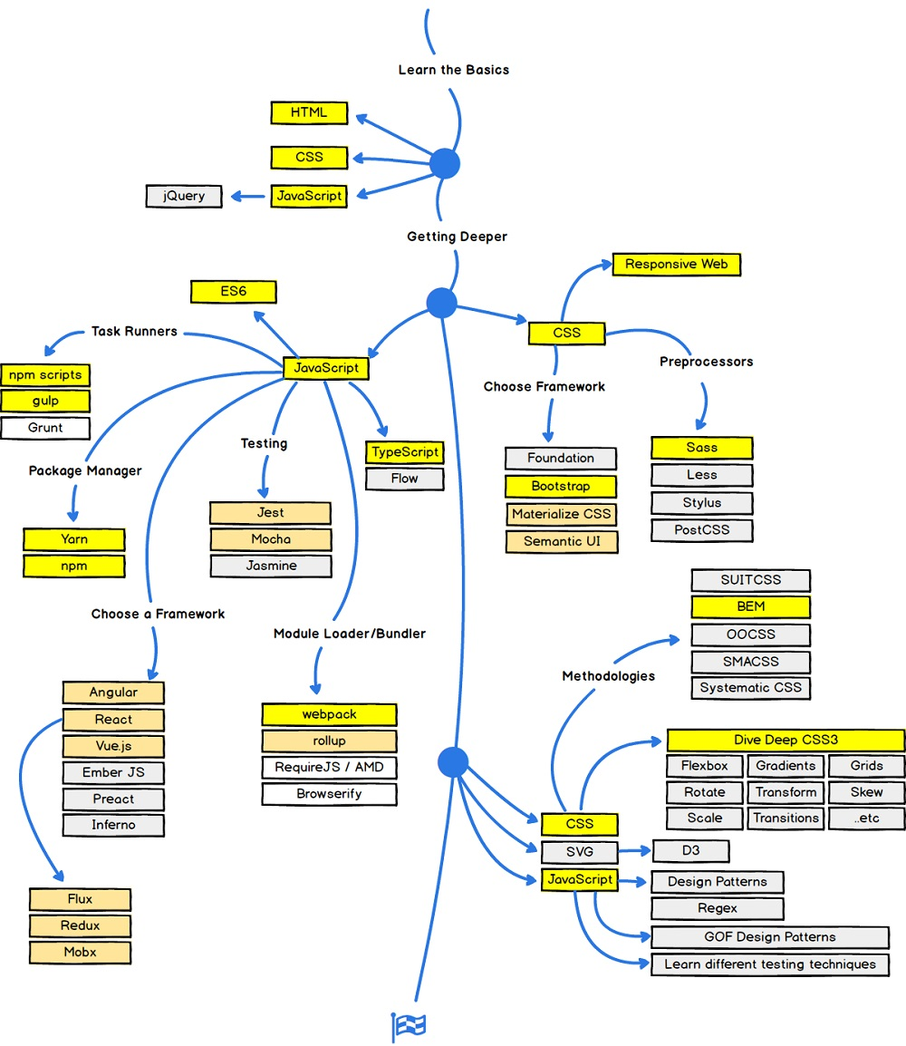
Web Development (Front-end)

Slide 24
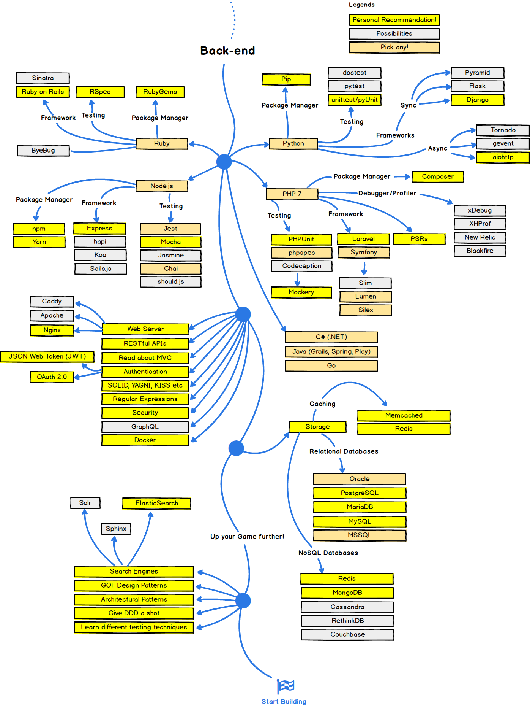
Web Development (Back-end)

Slide 25
HTML
Web pages are created using Hypertext Markup Language (HTML)
A markup language is a set of characters or symbols that define a document’s logical structure
你是否曾經「檢視原始檔」?

Slide 26
HTML
<!DOCTYPE>
<HTML>
<HEAD>
<TITLE>A Small Hello</TITLE>
</HEAD>
<BODY>
<H1>Hi</H1>
<P>This is very minimal "hello world" HTML document.</P>
</BODY>
</HTML>

Slide 27

HTML
HTML became an Internet standard in 1993 with the release of version 1.0
The version of HTML (4.01) was released in 1999
HTML 5, Oct. 2014. (HTML 5.2 2018)
<video>, <audio>, <header> and <canvas> elements,
include and handle multimedia and graphical content on the web without having to resort to proprietary plugins and APIs.
enrich the semantic content of documents.

Slide 28
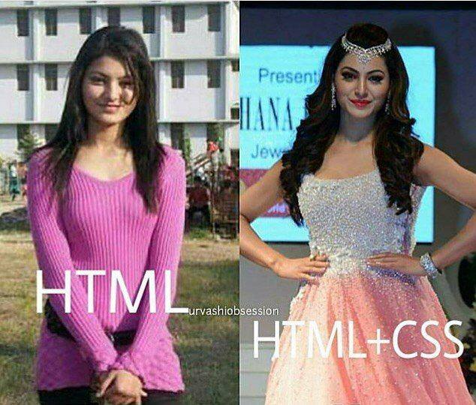
Cascading Style Sheets (CSS)
a style sheet language used for describing the look and formatting of a document written in a markup language
designed primarily to enable the separation of document content (HTML) from document presentation, including elements such as the layout, colors, and fonts

Slide 29
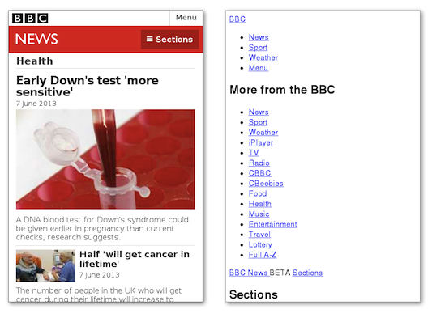
Cascading Style Sheets (CSS)

Slide 30
Bootstrap
The most popular HTML, CSS, and JavaScript framework for developing responsive, mobile-first web sites
makes front-end web development faster and easier
Examples
Theme templates

Slide 31
Javascript
JavaScript (JS) is a dynamic computer programming language
It is most commonly used as part of web browsers, whose implementations allow client-side scripts to
interact with the user,
control the browser,
communicate asynchronously,
and alter the document content that is displayed

Slide 32
Javascript
<html>
<head>
<script type="text/javascript">
document.write("Hello World!");
</script>
</head>
<body>
... etc.

Slide 33
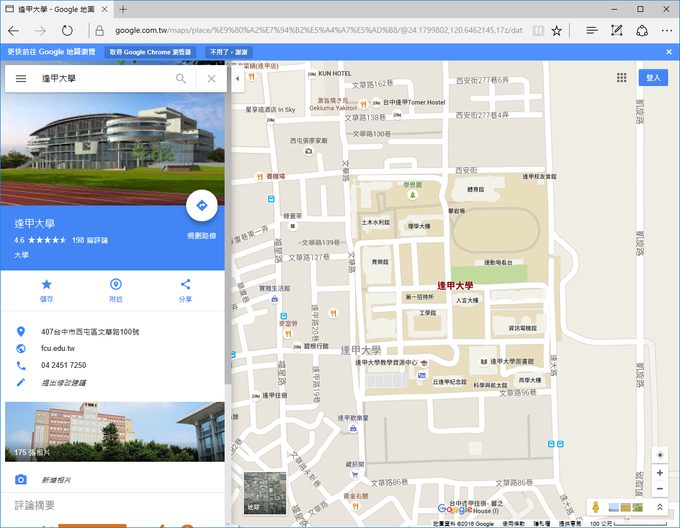
Javascript

Slide 34

AngularJS
a JavaScript-based open-source front-end web framework
maintained by Google and by a community of individuals
corporations to address many of the challenges encountered in developing single-page applications
provides a framework for client-side model–view–controller (MVC) and model–view–viewmodel (MVVM) architectures
https://angular.io

Slide 35
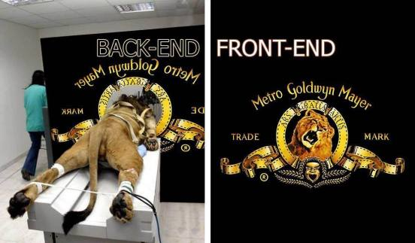
Front-end v.s. Back-end

Slide 36
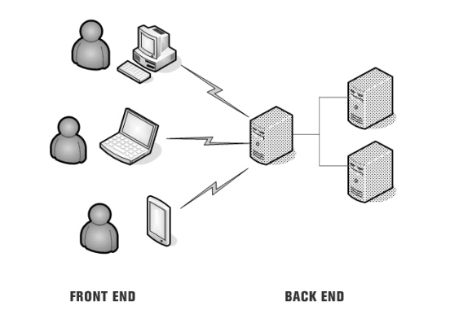
Front-end v.s. Back-end

Slide 37
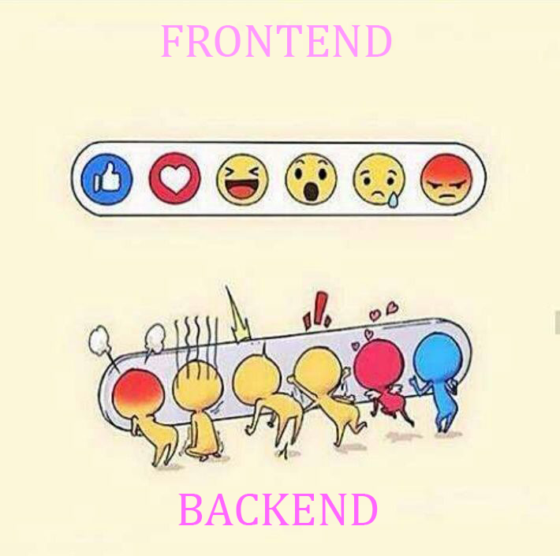
Front-end v.s. Back-end

Slide 38
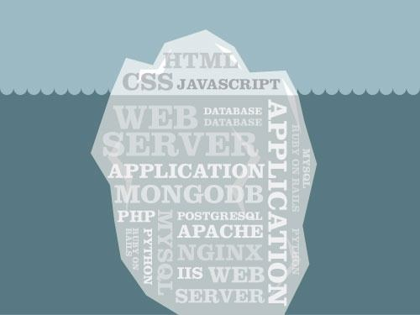
Front-end v.s. Back-end

Slide 39
Back-end Programming
Node.js
is an open-source, cross-platform JavaScript run-time environment that executes JavaScript code outside of a browse
lets developers use JavaScript to write Command Line tools and for server-side scripting—running scripts server-side to produce dynamic web page content before the page is sent to the user's web browser
Corporate users of Node.js software include GoDaddy, Groupon, IBM, LinkedIn, Microsoft, Netflix, PayPal, Rakuten, SAP, Tuenti, Voxer, Walmart, and Yahoo!.

Slide 40
Schedule
Week | Subject
1 | Introduction
2 | HTML
3 | Invited Speaker
4 | CSS
5 | 1st project report
6 | Bootstrap
7 | JavaScript 1
8 | JavaScript 2
9 | Google Map
Week | Subject
10 | AngularJS 1
11 | 2nd project report
12 | AngularJS 2
13 | AngularJS 3
14 | Node.js 1
15 | Node.js 2
16 | Node.js 3
17 | Project Development
18 | Project Demo

Slide 41
Grading
2 Project Report: 30 %
Project Demonstration: 20%
Assignment: 30 %
Exam: 20%
Team Project
Team: 3 ~ 4 students

Slide 42

Project
基於大學的社會責任，我們所學的知識應該對我們的社會我們的土地有所貢獻
邀請偏鄉部落學者介紹
偏鄉部落的特色、文化與風景等
偏鄉部落居民的需求
交通
教育
資訊設備
農產品買賣
專題的主題為『製作可以幫助偏鄉部落居民的網站』

Slide 43
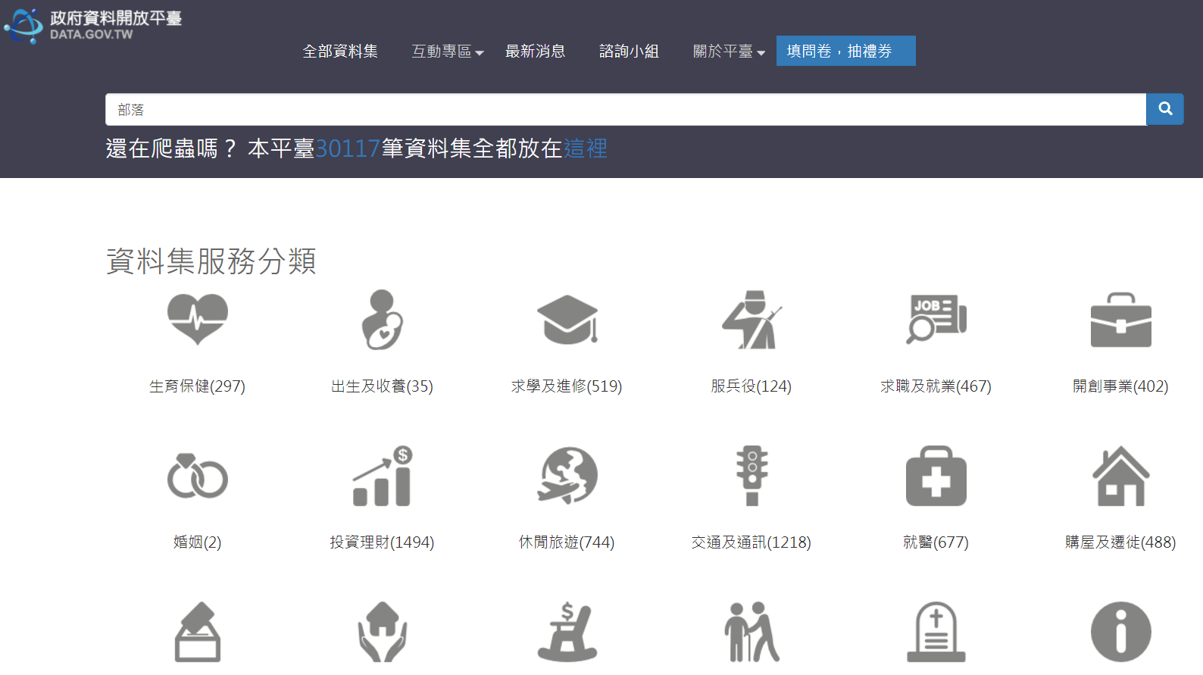
Open Data
政府開放資料平台
https://data.gov.tw/

Slide 44
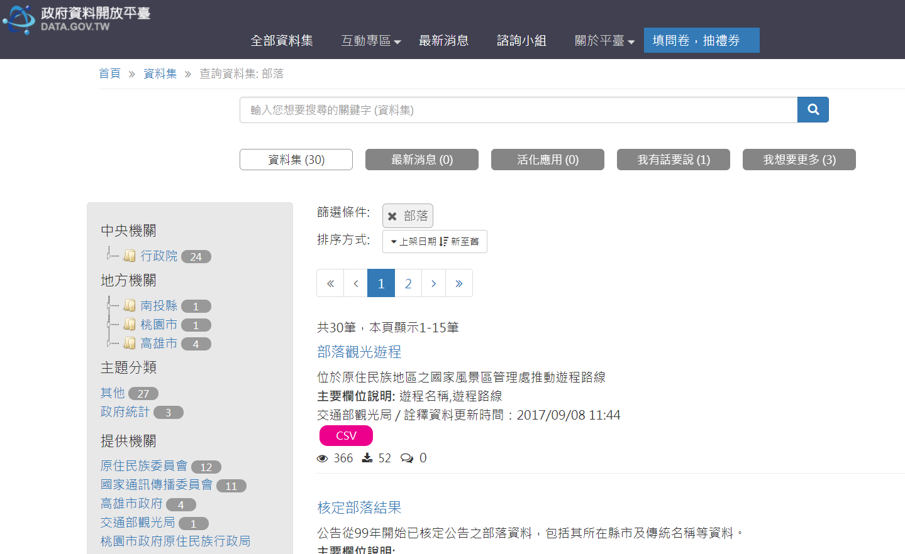
Open Data

Slide 45
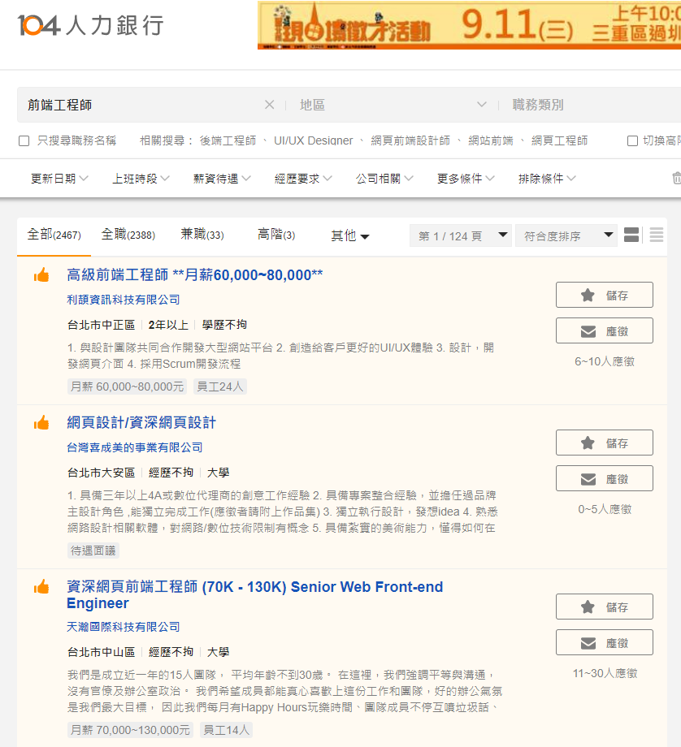
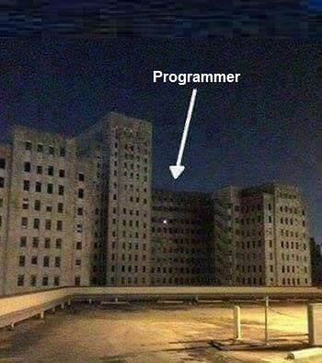
Be a programmer

